Slide 1
Aptiv AS&UX Instructions for Submitting PPAP for Component Parts to the PPAP Dropbox on the Aptivsupplier.com website
Revised May 2019

Slide 2
These instructions apply to any of the following PPAP submission scenario’s for Aptiv AS&UX components.
For Purchased Components:
Select the drop Down Box (see page 8) “Aptiv PPAPs”
  Initial part approval for all components
  Circuit Board routing to punching (normal course of business) changes
  New tools to replace worn out tools changes
  Additional cavities being added/approved in an existing tool where other cavities have been approved on the initial part approval
  Approvals to additional revisions on custom, Product Line owned parts (i.e. brackets, trimplates, pushbuttons, circuit boards, etc.) where the PL has already approved the change
Select the Drop Down Box (see page 8) “Aptiv PPAPs for SCRs and DWG Update”.
  All other supplier requested changes to parts that have Full PPAP approval and do not fit the examples above.

Slide 3
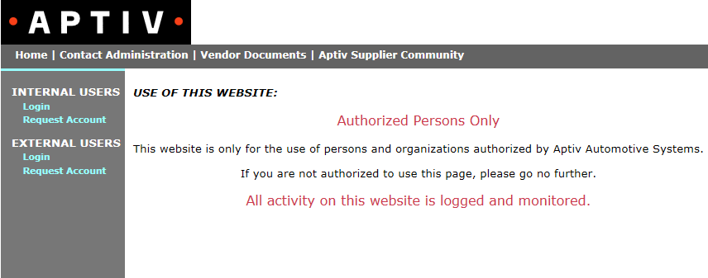
1) Go to www.aptivsuppliers.com. If you are logging on the first time and need to request an account, select “External Users Request Account” and submit a request for an account. If you already have an account, select “External Users Login”.

Slide 4
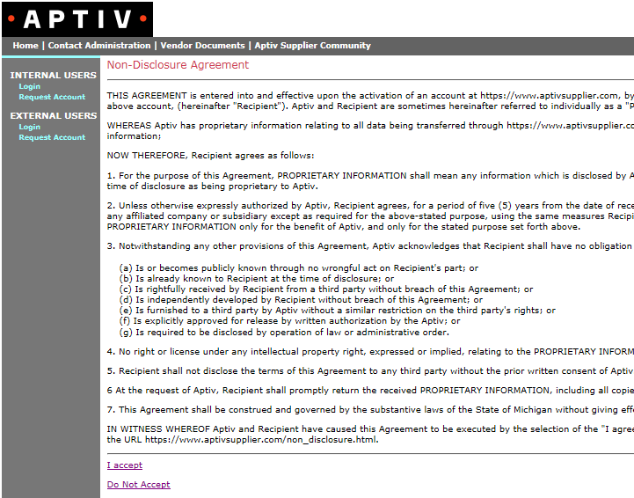
2) Read the non-disclosure agreement, click “accept” at the bottom of the page, and then you will asked to enter your login information.

Slide 5
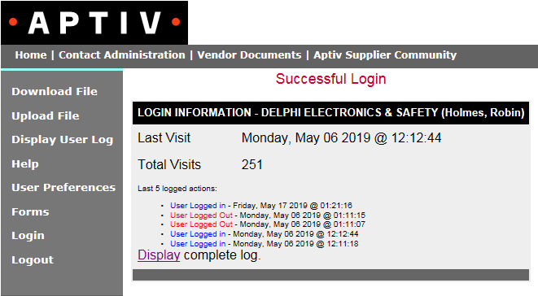
3) After a successful log-in, you will select “Upload File” from the screen shown below.

Slide 6
How should your PPAP file be structured?
The PPAP file you upload needs to be zipped. It can be in a PDF format or it can be multiple files that are zipped together.
Please make sure your file name contains the Aptiv part number.
Please make sure your PPAP file has the 18 elements of PPAP (as defined in the 4th edition AIAG PPAP manual), and make sure they are clearly identified to assist the approvers in locating their particular sections easily.
Please submit one part number per PPAP package. The only exception would be parts on charts.
NOTE: Until IT separation between Aptiv & Delphi Technologies is finished, Aptiv drawings will still show Delphi.

Slide 7
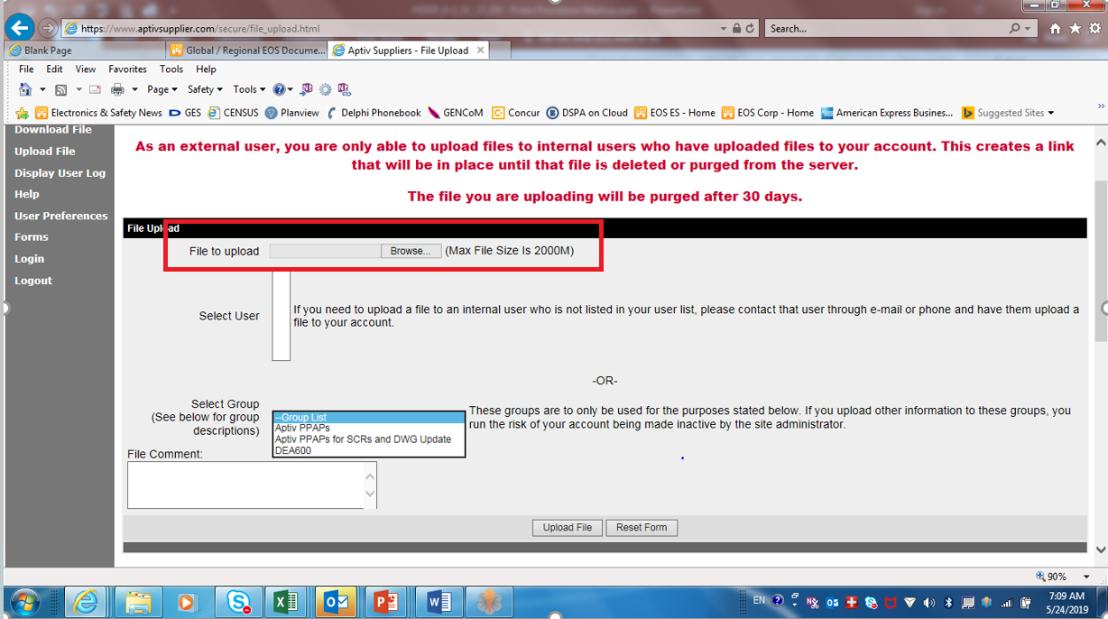
4) In the Upload File screen enter the file name or use the browse button to select the “file to upload”.

Slide 8
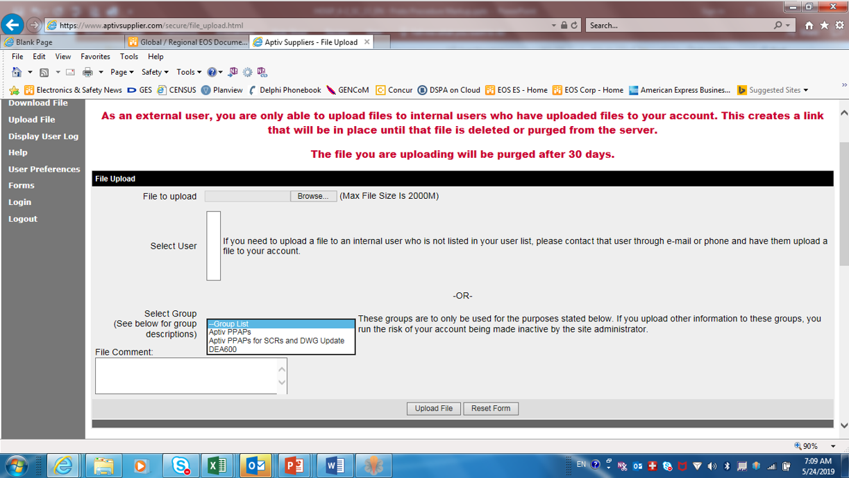
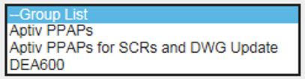
5) Select “Aptiv PPAPs” (See A below ) from the Group List menu. DO NOT USE the “Select User” dropdown list.
- For subsequent PPAP submissions related to SCR (Supplier Change Requests) use “Aptiv PPAPs for SCRs and DWG Update”(See B).
Note: Refer to page 2 if unsure what types of PPAPs are to be submitted to this drop box. PPAP packages affected by conditions (exceptions) noted on slide 2 shall be submitted as Initial PPAP Packages not as SCR PPAP packages.
6) Type in any comments you think may be helpful in the “File Comment” box. See C.
C
A
B

Slide 9
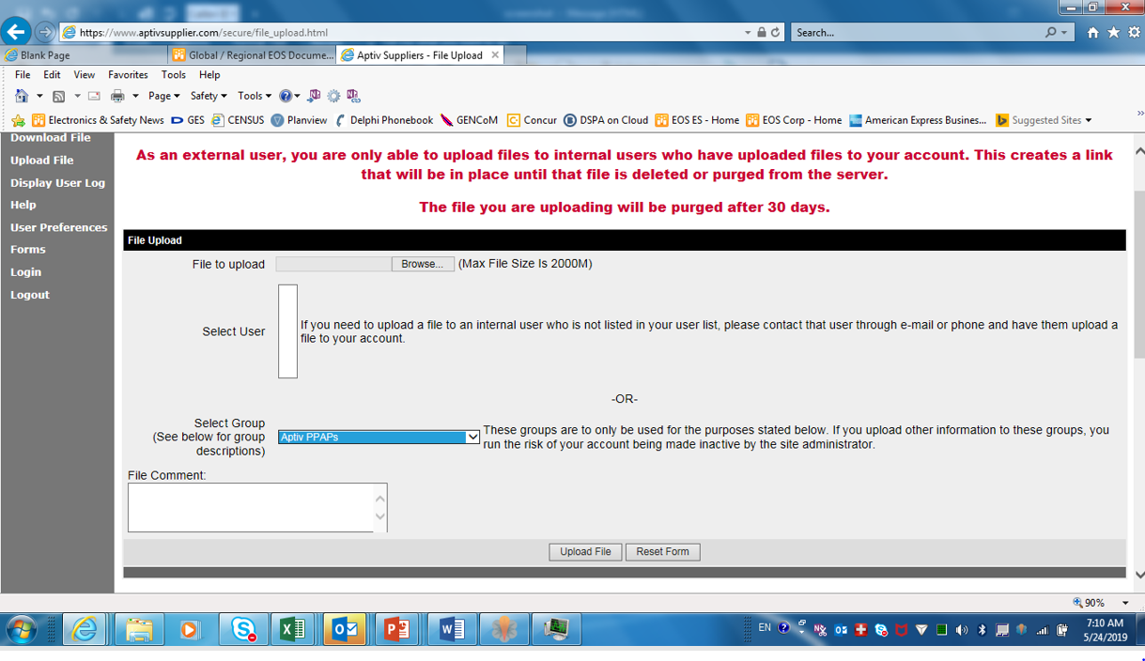
7) When complete, the “Upload File” screen should look something like what is shown below. After you have completed filling out the “Upload File” screen, click the “Upload File” button below the File Comments box to submit the PPAP. You should receive an e-mail saying the file was successfully uploaded. The file you are uploading will be purged from the database after 30 days.

Slide 10
Where do you send mechanical part samples if applicable?
Mechanical part samples including PPAP level 3 parts should be shipped directly to the Aptiv AS&UX engineer your company is working with. If you do not have the Aptiv contact information for shipping samples, then you can use the following address information below. Please include a copy of the PSW you submitted with your electronic PPAP package when shipping sample parts.
If you are not sure who to send mechanical sample to, contact the Aptiv Advanced Quality Engineer.

Slide 11
Requirements for a PPAP to be processed
The PSW (part submission warrant) must show
  the part drawing revision that is being PPAPed
  the correct manufacturing DUNS code that will supply the part
  the IMDS tracking number if the part is a purchased part
  Note: For PSW instructions see pages 13 and 14.
The drawing must be officially released in the Aptiv drawing system.
  NOTE: Until IT separation between Aptiv & Delphi Technologies is finished, Aptiv drawings will still show Delphi.
The part must be officially sourced if it is a purchased part.

Slide 12
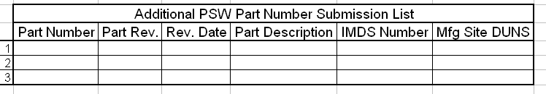
Requirements for PSW / PPAP
The PSW MUST be compliant to the AIAG Production Part Approval Process PPAP Manual, 4th Edition
  Reference Appendix A “Completion of the Part Submission Warrant (PSW)” PPAP 4th Edition, page 22 – 23.
PPAP submissions for Chart Drawings ONLY, MUST have an attached form with each part number listed as indicated.
  Note: For revision naming assistance see pages 16-19.
All PPAP documentation MUST be in English or include an accurate English translation on them.

Slide 13
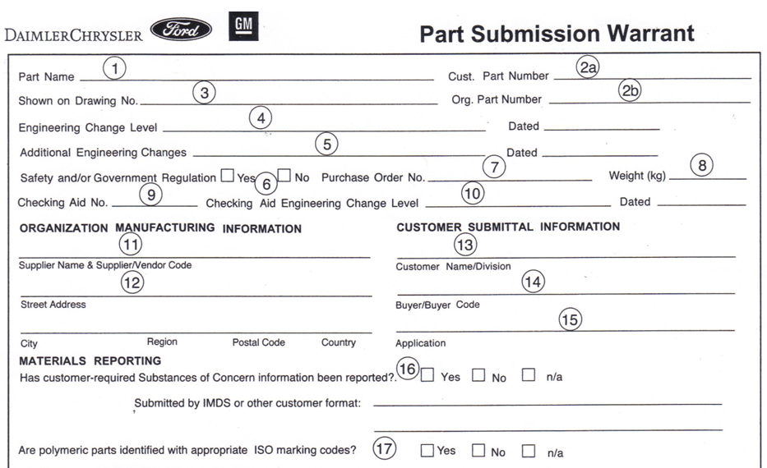
Requirements for PSW
Red wording is required - blank spaces put N/A if not applicable
Aptiv Part Name as on Aptiv Drawing
Aptiv Part Number
Aptiv P/N
Supplier P/N
Aptiv Drawing Revision
Aptiv Drawing Date
0.0018 kg
Supplier Mfg / Fab Site & DUNS
Aptiv
Supplier Mfg / Fab Site Address
Check yes with IMDS number
X
IMDS Number
NOTE: Until IT separation between Aptiv & Delphi Technologies is finished, Aptiv drawings will still show Delphi.
Complete remaining form as specified in PPAP 4th Edition, page 22

Slide 14
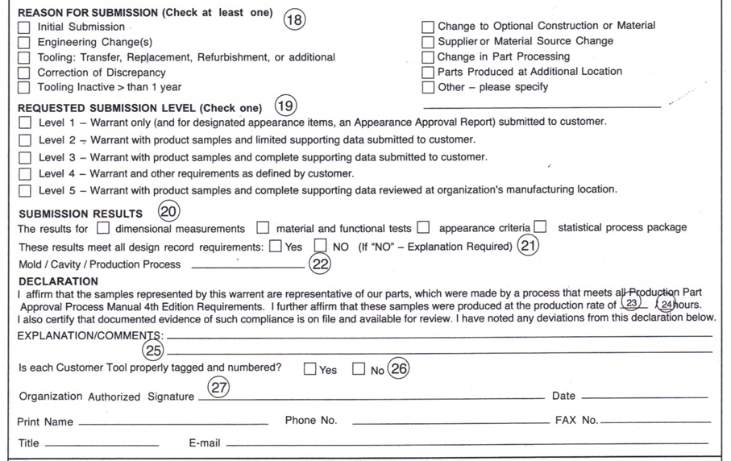
Requirements for PSW
Check correct box
Complete section 18-27 per PPAP 4th Edition Instructions
X
Check Level 4 when in doubt
X
Production rate and hours is a requirement for PPAP submissions
Additional remarks as needed. For mechanical/tooled parts include
Supplier Weekly Capacity (____) & Weekly Aptiv Program Requirements (_____)
Supplier Electronic Signature
Complete
Supplier Name
Supplier Phone Number
Fax Number
Supplier Title
Supplier Email
Red wording is required - blank spaces put N/A if not applicable

Slide 15
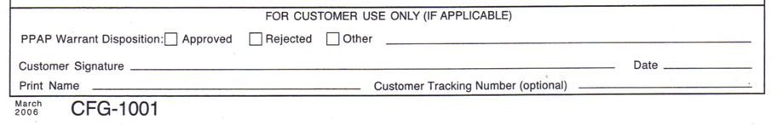
Requirements for PSW
Aptiv will not return a signed PSW to the submitting organization (supplier)
Use the Parts Approval Letter in-lieu-of the signed PSW
emailed by the Aptiv PPAP administrator

Slide 16
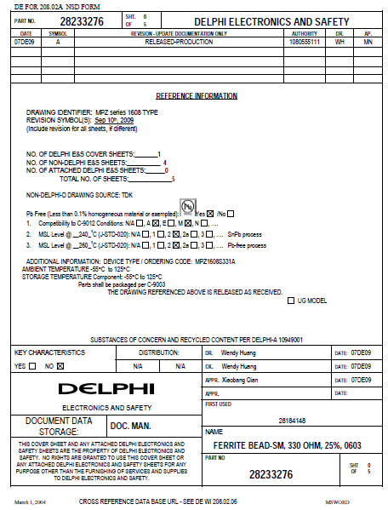


PSW Drawing Revisions (single part number)
Drawing Revision
PART REVISION & DATE IS FOUND HERE
PART NUMBER IS FOUND HERE
NOTE: Until IT separation between Aptiv & Delphi Technologies is finished, Aptiv drawings will still show Delphi.

Slide 17
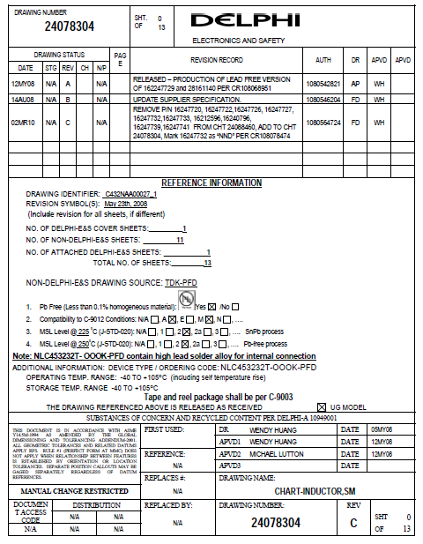
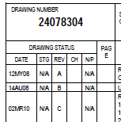

PSW Drawing Revisions (Chart part numbers)
Drawing Revision
Chart part number
Do Not Use on PSW
Chart Drawing
Cover Page
Chart Revision
Do Not Use on PSW

Slide 18
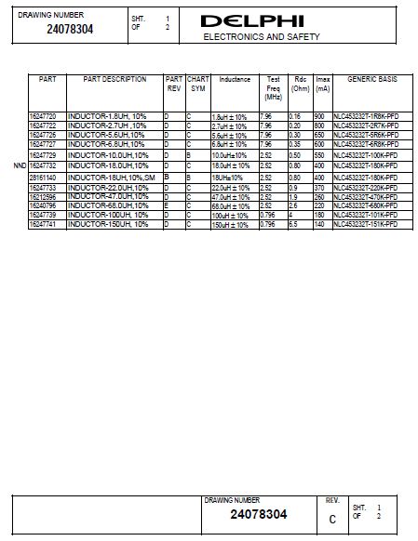
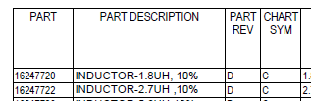
PSW Drawing Revisions (Chart part numbers)
Drawing Revision
Use this part Number &
Revision Number for the PSW

Slide 19
PSW Drawing Revisions (Chart part numbers)
Drawing Revision
Chart Drawing
Cover Page
USE THIS DATE
ON PSW

